Slide 1






Introduction to UNIX
John A. Juma
Animal and Human Health
International Livestock Research Institute (ILRI)
March, 2023
j.juma@cgiar.org

Slide 2
Objectives
What is UNIX
Basic UNIX commands
Redirection/Pipes
File system security/permissions
Other useful UNIX commands

Slide 3
UNIX is an operating system (OS) first developed in the 1960s by Ken Thompson and Dennis Ritchie.
Still under constant development ever since.
Features
Stable, multi-user, multi-tasking system for servers, desktops and laptops.
Flexible and easy to adopt to specific needs. UNIX philosophy – ‘small is good’ - each program is designed to do one job well.
Written in a machine independent language – UNIX can run on various hardware (laptops, desktops, super-computers).
Open source/freely available with open-source codes.
UNIX systems also have a graphical user interface (GUI) like Microsoft Windows which provides an easy-to-use environment.
What is UNIX

Slide 4
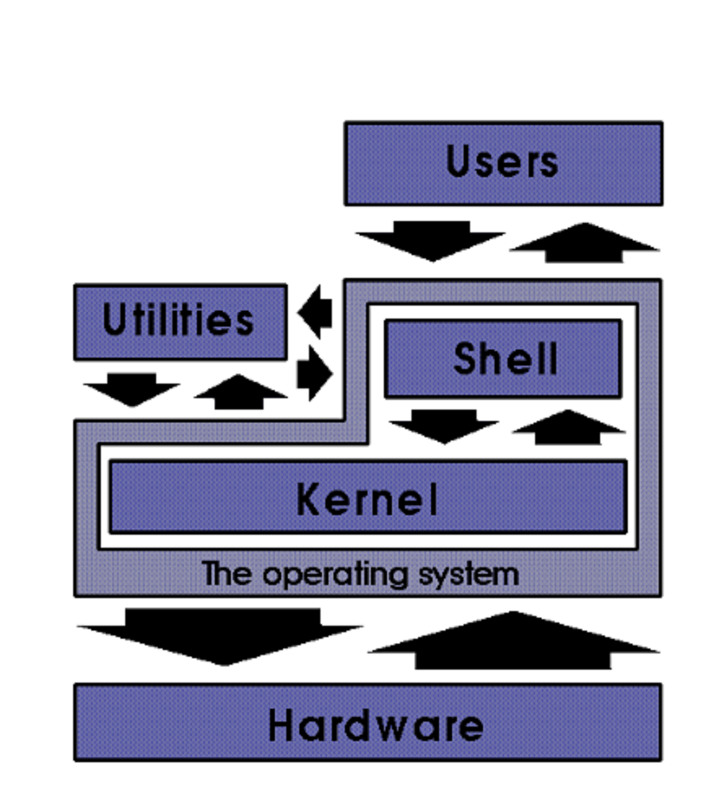
UNIX Anatomy
UNIX is multi-layered system
Kernel
Bottom layer of the system that provides a means for starting application programs (often also called user programs).
The kernel facilitates four basic types of services:
creation and management of processes
a filesystem
communications
a means to start the system
Kernel functions, such as allocation of memory and CPU, are performed without being explicitly requested by user processes.
Other functions of the kernel, such as resource allocation and process creation and management, are initiated by requests from processes.
These requests from processes come in the form of system calls. A system call can be thought of as a low-level request to the operating system (e.g., kill, fork, exec, exit, close)
Source: http://ibgwww.colorado.edu/~lessem/psyc5112/usail/concepts/anatomy-of-unix/anatomy.html

Slide 5
UNIX Anatomy
Process
In UNIX, a running program is called a process. A program that a process can be created from is called and executable.
The Shell
UNIX system user accesses the services of the kernel through an interface called a shell.
The shell is a command interpreter that allows the user to initiate processes to perform a nearly infinite variety of tasks.
Utilities
Utilities are programs that perform system functions. Utility can also refer to a command that is used to do work of some sort, such as mv to move files or directories.
Source: http://ibgwww.colorado.edu/~lessem/psyc5112/usail/concepts/anatomy-of-unix/anatomy.html

Slide 6
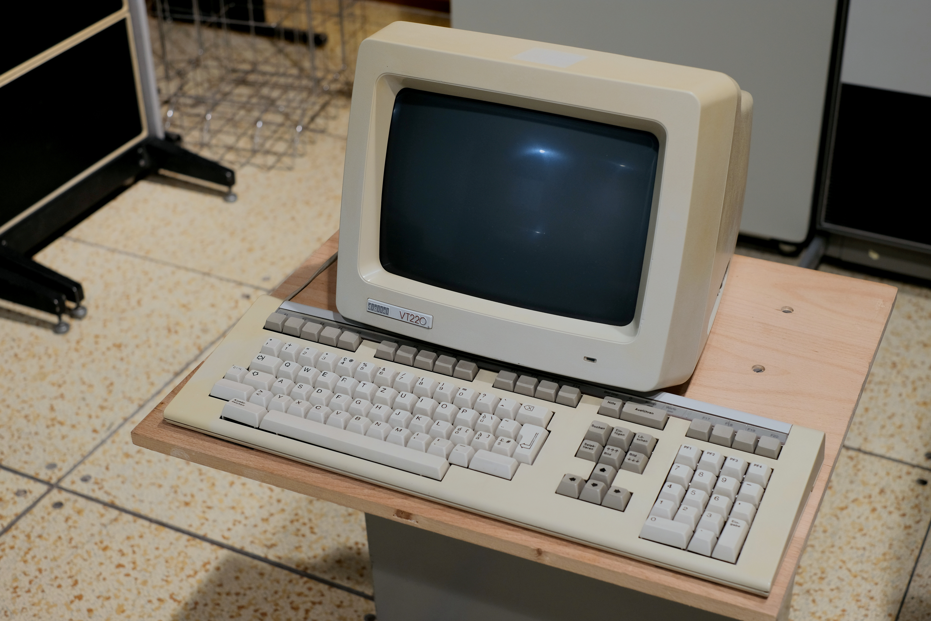
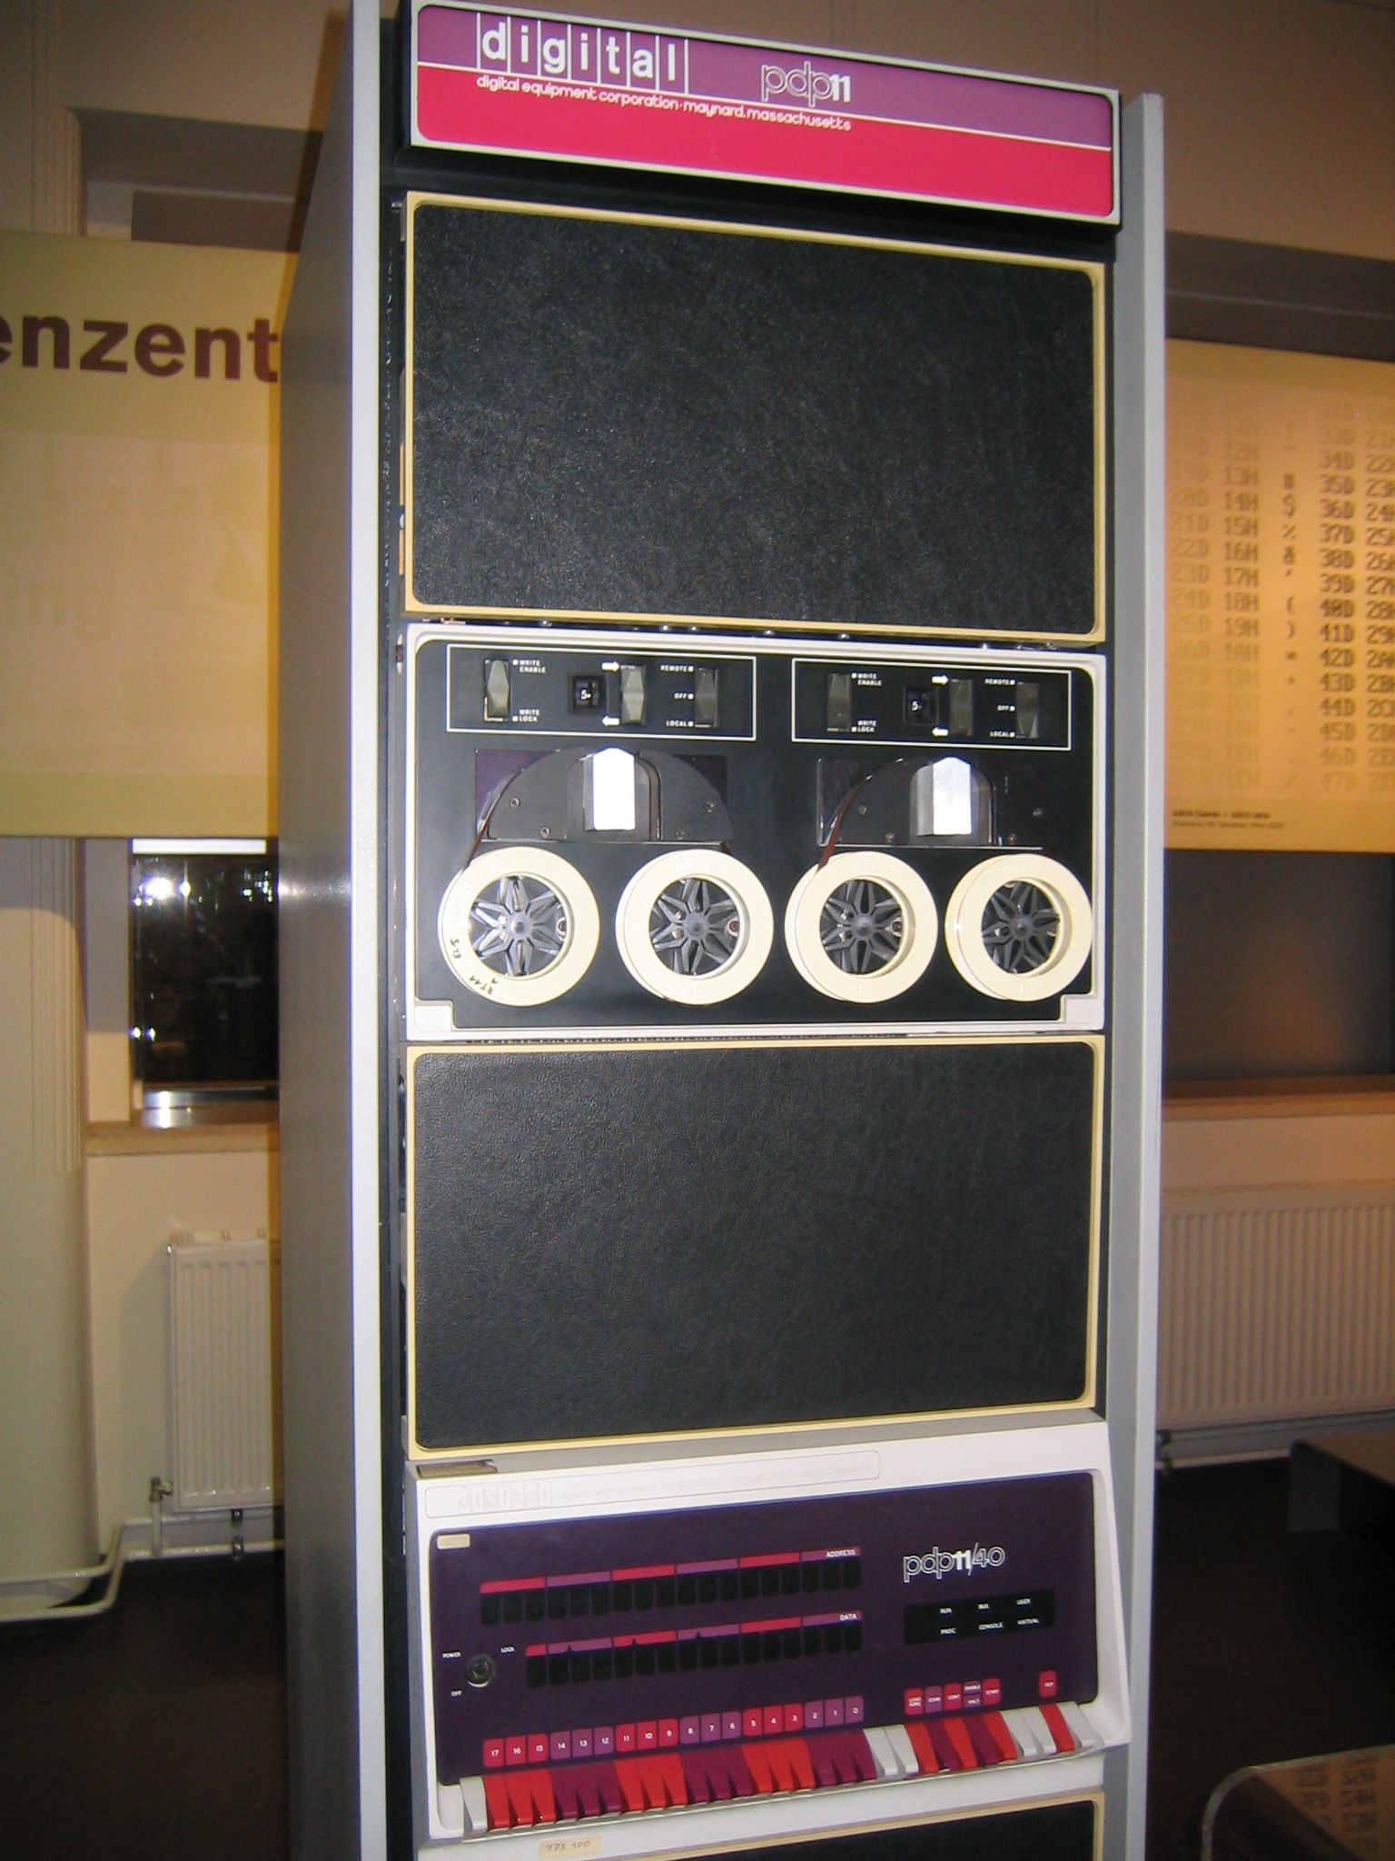
The Terminal
Originally, computers did not have integrated hardware for humans to use – e.g., they did not have integrated screens, keyboards, mice, track pads, etc.
Such human computer interface devices only arose with the advent of small personal computers (PC’s) designed and built largely for direct human use.
Source: https://jappavoo.github.io/UndertheCovers/textbook/unix/terminal.html

Slide 7
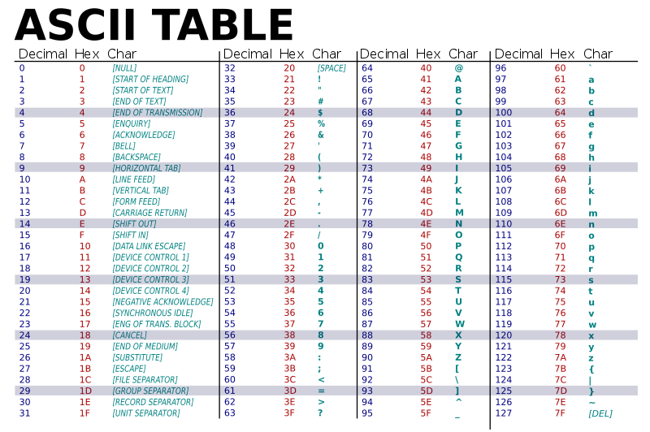
ASCII Terminal
ASCII terminals can translate ASCII encoded text data to display, e.g., “print”, the appropriate character on the screen.
For example, if the software running on the computer sent the number 65 to the terminal, the terminal would display capital ‘A’ at the current “cursor” position.
Terminals were the “natural” evolution of the classic typewriter.
Source: https://jappavoo.github.io/UndertheCovers/textbook/unix/terminal.html

Slide 8
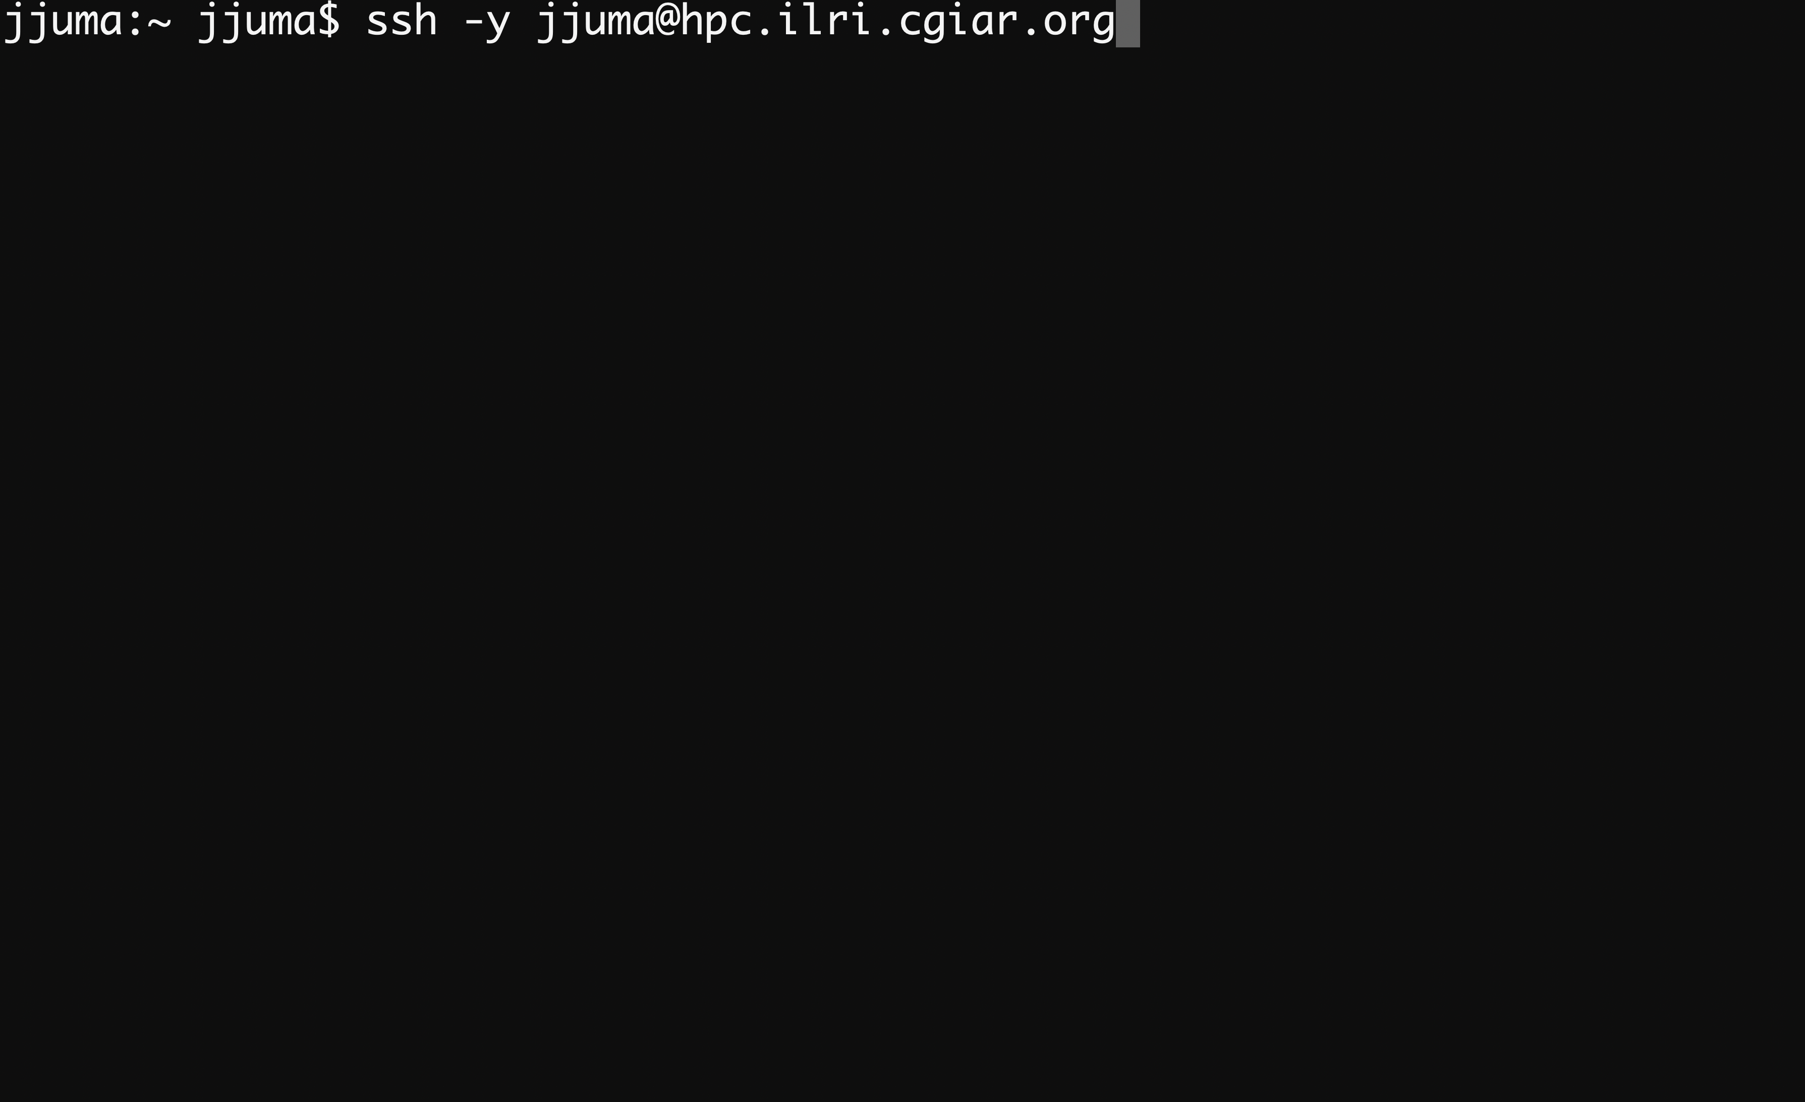
Terminal Emulators
Apple’s MacOSX Terminal
Window’s Terminal
Others: PuTTY, MobaXTERM
Both OSX and Windows provides a program called Secure Shell/Secure Shell Socket (SSH).
SSH allows you to use a terminal emulator running on your computer to connect to remote computers.

Slide 9
Exercises
A terminal provides a text-oriented way for a human to interact with a computer (TRUE/FALSE).
Which is the bottom layer of a UNIX system?
In UNIX, a task or job running on the system can be termed as a?
A program built from a process that can be executed in a UNIX system is called?
What program can you use to remotely connect to another computer?

Slide 10
Filesystem
A filesystem can be defined as a data structure or a collection of files.
UNIX system regards everything as a file. Files can be divided into three categories;
Ordinary or plain files.
Directories.
Special or device files.
In UNIX, filesystem can refer to two very distinct things; the directory tree or the arrangement of files on disk partitions.
The latter can be thought of as the physical filesystem as it has a tangible physical location.

Slide 11
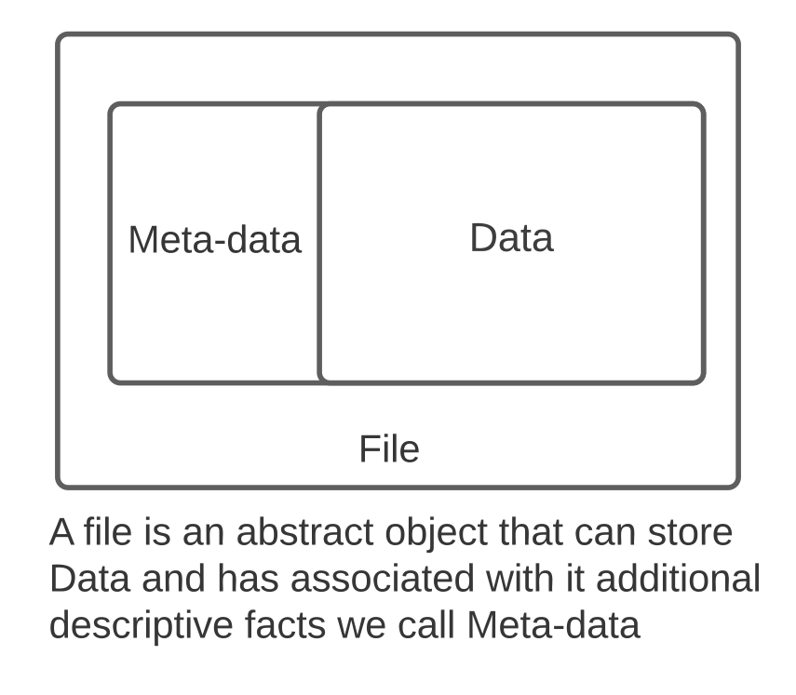
Filesystem: Files
A file is an abstract object that can store information. We can write and read contents to and from it.
Data of a file contain a collection of bytes. The bytes of the file might encode ASCII data, image data, audio data, an executable program, etc.
Metadata of a file are associated descriptive facts. Examples of these facts include:
who owns the file
the length of the file (measured in bytes)
who has permissions to read or write its contents
the time the contents was last modified
the time that it was last read
the time that the descriptive facts where last changed (e.g., the file permissions were modified)
Source: https://jappavoo.github.io/UndertheCovers/textbook/unix/terminal.html

Slide 12
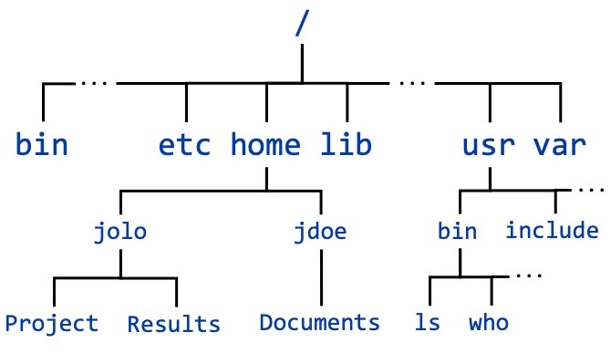
Filesystem: Directory tree
A directory contains a list of names each name identifies either a single file or another directory.
A directory that is within a directory is said to be a sub-directory.
A UNIX user is allowed to create directories and files and name them as they see fit. This ability allows a user to flexibility organize their information in a way they like and makes sense to them.
Source: https://cvw.cac.cornell.edu/linux/filesystem

Slide 13
Directory tree example
/
root
home
Directory
jjuma
File
lectures
assignments
UNIX
Shell-scripting
workflows
assignment-1.txt
science.txt
assignment-2.txt
intro.pdf
variables.pdf

Slide 14
Paths
In UNIX, the top of the tree is the one directory that always exists and is not a sub-directory of any other directory. This is the ROOT directory.
The name of the variables file at the bottom of the diagram is composed by joining the name of the directories leading to it along with its name at the end.
/ + home + jjuma + lectures + shell-scripting + variables
Notation for a full path name of a file or directory is by joining the independent components with the “/”.
/home/jjuma/lectures/shell-scripting/variables
Root path /

Slide 15
Paths
Absolute path
Details the entire path through the directory structure to get to a file, starting at /, the root directory
/home/jjuma/lectures/shell-scripting/variables
Relative path
Is the path from where you are now (your present working directory) to the file in question
../lectures/shell-scripting/variables

Slide 16
Exercises
A UNIX file is a physical object that exists on the computer’s hard-drive: True or False?
What is meta-data versus data with respect to files?
The directory structure and name of the directories is fixed: True or False?
In the directory tree example in the lecture what is the full path name of jjuma’s workflows directory?
In the directory tree example in the lecture what is the full path name of jjuma’s assignment files?
A directory can contain both files and directories: True or False?

Slide 17
Interacting with the Kernel
A core function of the shell is to be the first running process a human user of a computer can use to interact with the kernel to get things done. The Shell achieves this by:
accepting human oriented commands from a user.
executing kernel system calls to get the work of the commands done.
sending a response back.
The shell includes the ability to locate other executable programs and launch new processes from them.
The shell is text based and is designed with programmers in mind.
Shell variants
Bourne
BASH (Bourne Again Shell)
C shell (csh)
tcsh
Korn Shell (ksh)
Z Shell (zsh)

Slide 18
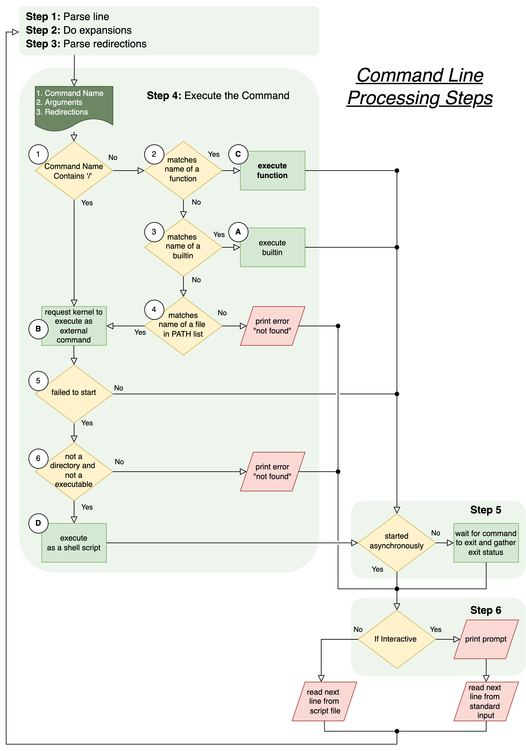
The command line
UNIX command lines can get quite complex.
A hallmark of UNIX expertise is the ability to compose long command lines that chain together many commands.
Learning to issue simple command lines is the first step to ruling the UNIX world.
When the shell receives a command line, it goes through a series of steps to process it. The rules of this processing define what is called the Shell Grammar.
Commands can be run interactively vs non-interactively (scripts)
Source: https://jappavoo.github.io/UndertheCovers/textbook/unix/terminal.html

Slide 19
Help commands
man pages (manual pages)
Linux includes a built-in manual for nearly all commands, so these should be your go-to reference.
man format and display manual pages
NAME – a one-line description of what it does.
SYNOPSIS – basic syntax for the command line.
DESCRIPTION – describes the program's functionalities.
OPTIONS – lists command line options that are available for this program.
EXAMPLES – examples of some of the options available
SEE ALSO – list of related commands.

Slide 20
Simple commands
Listing files and directories
ls lists the contents of your current working directory.
ls -a lists all the contents of your current working directory (including directories with a dot)
What does the command ls –lth do?
To list all the files in long format and show complete time information, which command can you use?
To list all the files in a directory and output in a comma-separated format, which optional flag can you use?

Slide 21
Simple commands
Making directories
mkdir make a directory.
Make a directory in your home directory and name it lectures
In lectures directory make additional sub-directories, unix-stuff and shell-scripting
Make another directory in your home directory and name it assignments

Slide 22
Simple commands
Changing directory
cd change directory.
Change directory to unix-stuff and list all the contents of the directory
Current directory
cd .
Parent directory
cd ..
Typing cd with no argument always returns you to your home directory.

Slide 23
Simple commands
Copying files
cp copy files
Typical command
cp file1.txt file2.txt copy file1.txt in the current working directory and name it file2.txt
Copy the science.txt file to the assignments directory.
Assuming you have a file named file1.txt in the current working directory, what does the command cp file1.txt . do?
Copy the lectures directory into assignments directory
Copy only the contents of assignments directory into lectures directory

Slide 24
Simple commands
Moving files
mv move or rename files
Typical command
mv source target rename
mv source directory move
Exercise
In your home directory, make a directory named backups and move the science.txt file from assignments to the backups directory.

Slide 25
Simple commands
Clearing the terminal screen
clear clear the terminal screen
Display content of a file
cat concatenate and print files
less display contents of a text file on terminal screen one page at a time
more display contents of a text file on terminal screen one page at a time
head display first lines of a file
tail display last lines of a file
Exercise
Display all the contents of the science.txt file
Display the last 5 lines in the science.txt file
Display the first 5 lines in the science.txt file

Slide 26
Simple commands
Searching the contents of a file
less display contents of a text file on terminal screen one page at a time
To search for a word in a text file, we can use the less command followed by the forward slash (/) and type the word to search. This will highlight all the occurrences of the word. Type [n] to search for the next occurrence of the word.
Exercise
Search for all the occurrences of the word science in the science.txt file

Slide 27
Simple commands
Searching the contents of a file with grep (global regular expression print)
grep searching and matching patterns in a file
grep is case sensitive. You can ignore this feature by using the flag –i, i.e grep –i
Exercise
grep science science.txt
Search for all occurrences of the word science, ignore case sensitivity.
Display lines that do not match the word science.
Print only the total count of the matched lines.
Display the line that match preceded by the line number.

Slide 28
Simple commands
Word and line counts
wc word, line, character and byte count
Exercise
wc science.txt
How many lines are in the science.txt file.
How many characters are in the science.txt file.
What is the size of the science.txt file in bytes?

Slide 29
Simple commands
I/O and Redirection
Most processes in UNIX:
standard input (stdin): stream data going into a program. By default, this is input from the keyboard.
standard output (stdout): output stream where data is written out by a program. By default, this output is sent to the screen.
standard error (stderr), another output stream (independent of stdout) where programs output error messages. By default, error output is sent to the screen.
The output of a process or program can be saved using the redirection operator >.
For example, you can redirect the output of the command ls to a file by:
ls –lth > list_of_files.txt
This will create a file called list_of_files.txt or overwrite it if it does not exist.
If you know that the file exists, you can append more content by using the operator >>
ls –lth >> list_of_files.txt

Slide 30
Simple commands
I/O and Redirection
Redirect the standard input into a file using > operator.
cat > list1
Type the following in an interactive manner
pear
banana
Apple
Exit the terminal by hitting Ctrl ^ [d]

Slide 31
Simple commands
I/O and Redirection
Redirect the standard input into a file using > operator.
cat > list1
Type the following in an interactive manner
pear
banana
apple
Hit Ctrl ^ [d] to stop the input stream
Using the above method, create another file called list2 containing the following fruits: orange, plum, mango, grapefruit. Read the contents of list2
Concatenate the two lists, list1 and list2 and name the resulting list as biglist.

Slide 32
Simple commands
Sort items
Type sort and enter the following
dog
cat
bird
ape
Hit Ctrl ^ [d] to stop the input stream

Slide 33
Simple commands
Input Redirection
Input can also be given to a command from a file instead of typing it in the shell by using the redirection operator <.
cat < science.txt
Error Redirection
rmdir no-dir 2> nodir_error.txt
Merge stdout with stderr
cat science > combined_output.txt 2>&1
Use biglist as input stream, sort the list and redirect to a standard output list called slist

Slide 34
Simple commands
Pipes
who Display who is logged in
One method to get a sorted list of names is to type,
who > names.txt
sort < names.txt
This is a bit slow, and you must remember to remove the temporary file called names.txt when you have finished. What you really want to do is connect the output of the who command directly to the input of the sort command. This is exactly what pipes do. The symbol for a pipe is the vertical bar |
who | sort
Print the count of sorted list of all users logged in
Using pipes, display all lines of list1 and list2 containing the letter 'p', and sort the result.

Slide 35
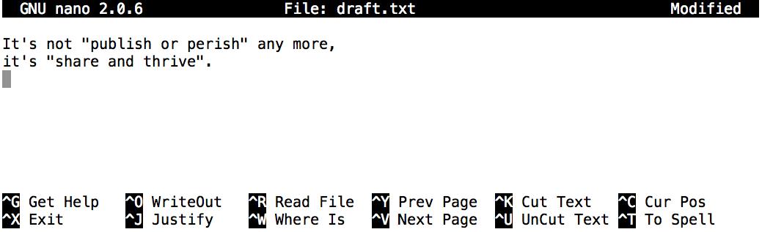
Simple commands
Creating files
Files containing texts can be created using text editors such as nano, vi, vim on command line
Create a text file named draft.txt in a directory called thesis using nano and type the texts as shown on the screenshot below.
Once we’re happy with our text, we can press Ctrl+O (press the Ctrl or Control key and, while holding it down, press the O key) to write our data to disk (we’ll be asked what file we want to save this to: press Return to accept the suggested default of draft.txt).
https://swcarpentry.github.io/shell-novice/03-create/index.html

Slide 36
Other commands
Redirect and save output
To have the output go to both a file and the screen simultaneously.
cat science.txt | tee out.stdout.txt
You can also use tee to catch stderr with:
rmdir no-dir | tee out.stderr.txt

Slide 37
Other commands
Wildcards
* is a wildcard, which matches zero or more characters. Let’s consider the shell-lesson-data/exercise-data/proteins directory: *.pdb matches ethane.pdb, propane.pdb, and every file that ends with .pdb.
On the other hand, p*.pdb only matches pentane.pdb and propane.pdb, because the ‘p’ at the front only matches filenames that begin with the letter ‘p’.

Slide 38
File naming conventions
A directory is merely a special type of file. So, the rules and conventions for naming files apply also to directories.
In naming files, characters with special meanings such as / * & % , should be avoided. Also, avoid using spaces within names. The safest way to name a file is to use only alphanumeric characters, that is, letters and numbers, together with _ (underscore) and . (dot).
Examples
Good filename | Bad filename
assignment.txt | assignment
merged_files.txt | merged files.txt
dengue_and_chikungunya.fasta | dengue & chikungunya.fasta
metadata.csv | meta data.csv
project-dir | project dir

Slide 39
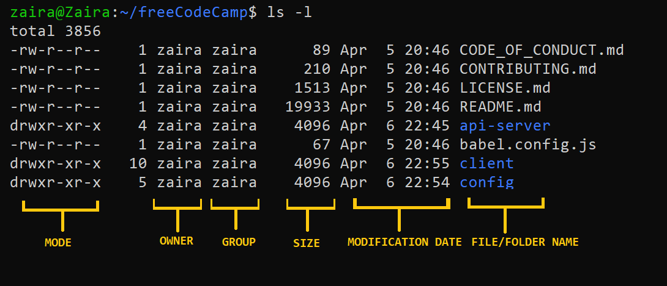
File permissions
In UNIX, there are three types of owners: user, group, and others.
File permissions fall in three categories: read, write, and execute.
 | Read | Write | Execute
Files | Open, read | Edit, Delete, Save (Modify) | Run an executable file (script)
Directories | Listing without modification | Create, Delete, Rename contents | Access
user (u) | group (g) | others (o)
rwx | rwx | rwx
https://www.freecodecamp.org/news/linux-chmod-chown-change-file-permissions/

Slide 40
File permissions – changing permissions
chmod change file modes
Syntax
chmod permissions filename
Where,
permissions can be read, write, execute or a combination of them.
filename is the name of the file for which the permissions need to change. This parameter can also be a list if files to change permissions in bulk.
We can change permissions using two modes:
Symbolic mode: this method uses symbols like u, g, o to represent users, groups, and others. Permissions are represented as r, w, x for read write and execute, respectively. You can modify permissions using +, - and =.
Absolute mode: this method represents permissions as 3-digit octal numbers ranging from 0-7.

Slide 41


File permissions – changing permissions
Suppose I have a script and want to make it executable for the owner, jjuma.
I can change the file permission using the command
chmod u+x fastqc-run.sh
What would the commands below do to the script?
chmod go+x fastqc-run.sh
chmod o-r fastqc-run.sh
chmod g=w fastqc-run.sh

Slide 42
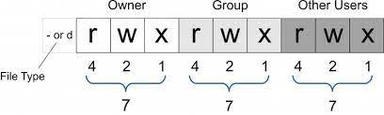
File permissions – changing permissions using absolute mode
Absolute mode uses numbers to represent permissions and mathematical operators to modify them.
Permission | Assign permission | Revove permission
Read | Add 4 | Subtract 4
Write | Add 2 | Subtract 2
Execute | Add 1 | Subtract 1

Slide 43
File permissions – changing permissions using absolute mode
Set read for user, read and execute for group, and only execute for others.
chmod 451 filename
Remove execution rights from others and group.
chmod 440 filename
 | Read | Write | Execute | Sum
user | 4 | 0 | 0 | 4
group | 4 | 0 | 1 | 5
others | 0 | 0 | 1 | 1
 | Read | Write | Execute | Sum
user | 4 | 0 | 0 | 4
group | 4 | 0 | 1 - 1 | 4
others | 0 | 0 | 1 - 1 | 0

Slide 44
File permissions – changing permissions using absolute mode
If the resulting mode of chmod 451 is equivalent to r--r-x—x?
Write the resulting file modes for the following
chmod 777 filename
chmod 754 filename
chmod 700 filename

Slide 45
Other useful commands and syntax of shell command
wget
history
zcat
find
gzip
df
file
diff

Slide 46
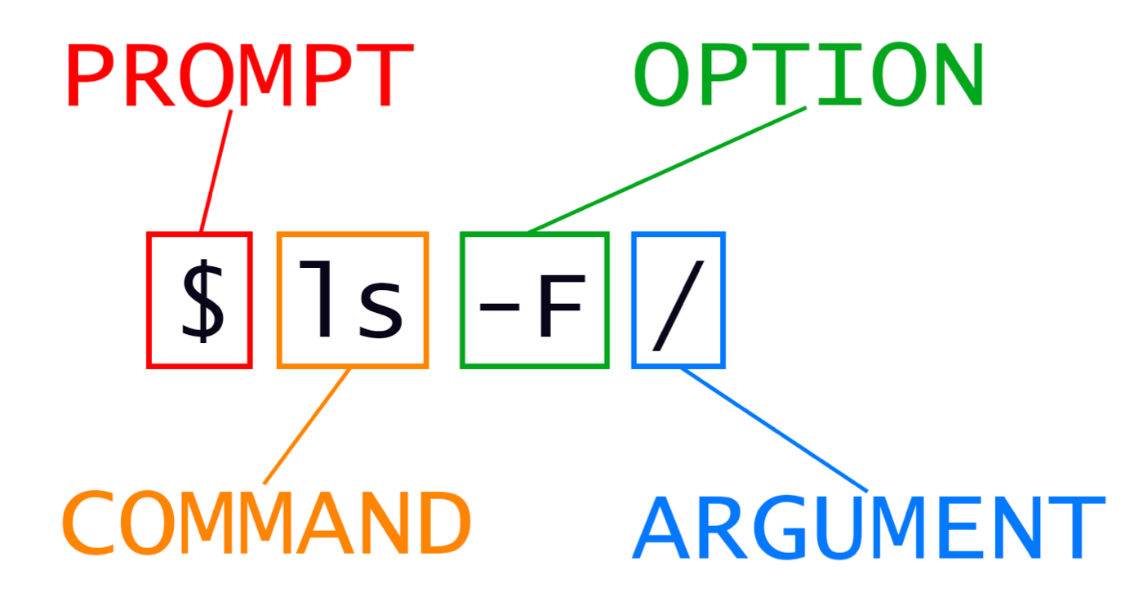
Syntax of shell command

Slide 47
Setup
Download the data from https://swcarpentry.github.io/shell-novice/data/shell-lesson-data.zip
https://swcarpentry.github.io/shell-novice/01-intro/index.html

Slide 48
Other useful commands and syntax of shell command
cut cut out selected portions of each line of a file
In the animal-counts sub-directory within exercise-data directory, run the command
cut -d , -f 2 animals.csv
We can further obtain uniq animals by using the command
cut -d , -f 2 animals.csv | sort | uniq

Slide 49
Challenge
Starting from /Users/amanda/data, which of the following commands could Amanda use to navigate to her home directory, which is /Users/amanda?
cd .
cd /
cd /home/amanda
cd ../..
cd ~
cd home
cd ~/data/..
cd
cd ..

Slide 50
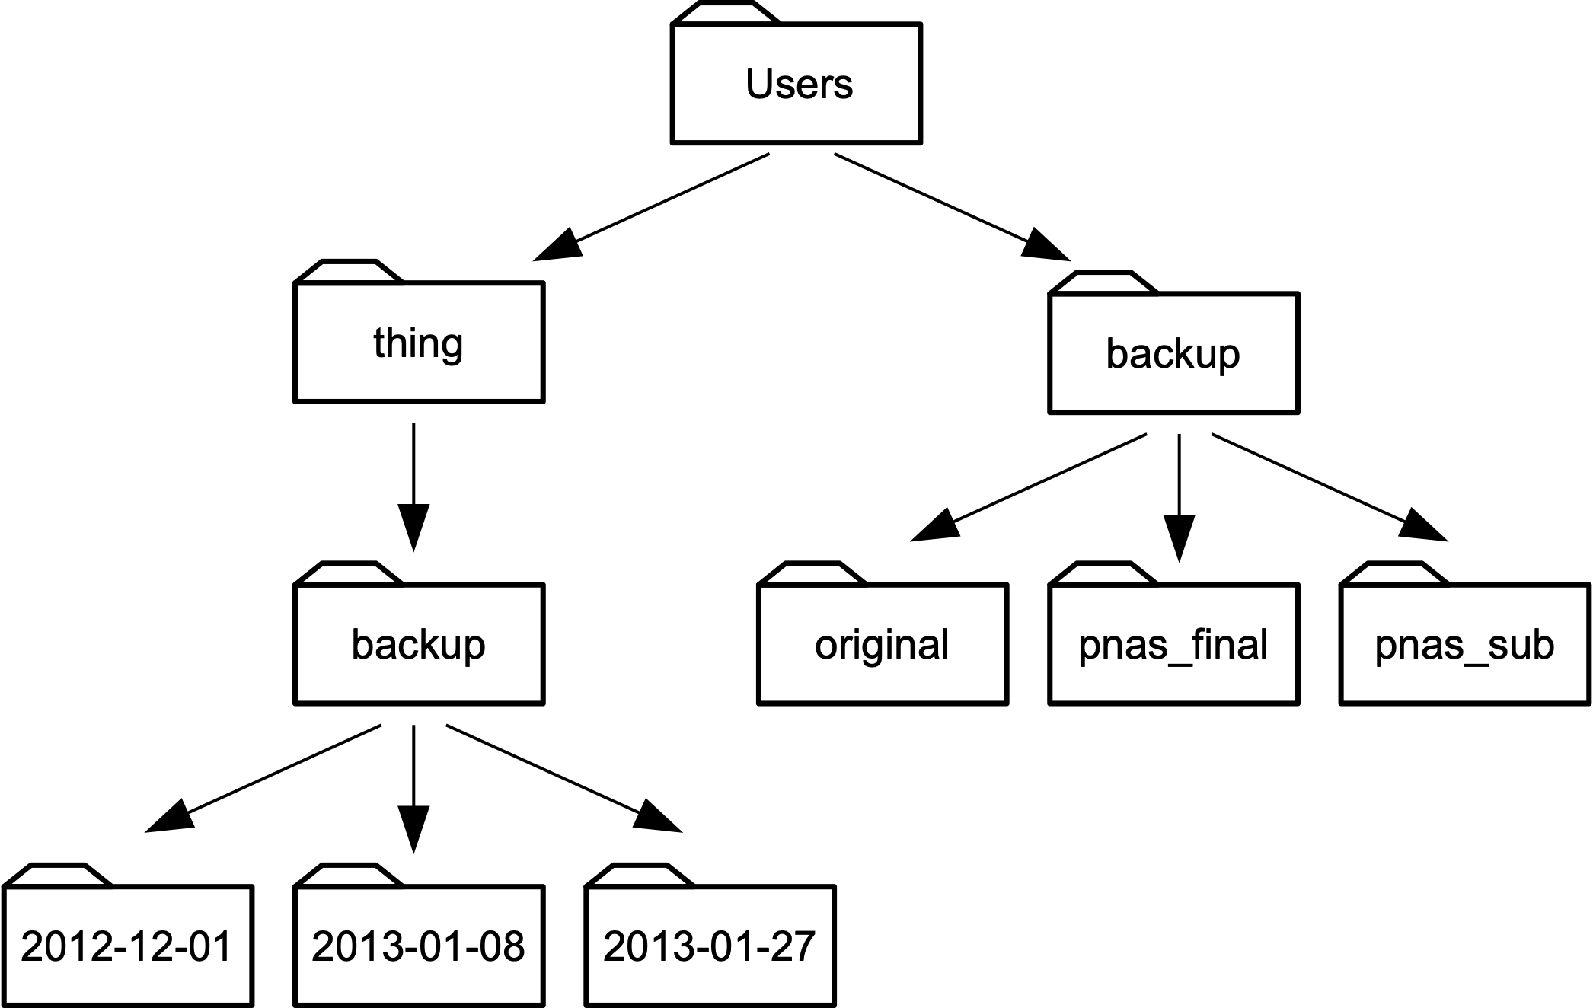
Challenge
Using the filesystem diagram below, if pwd displays /Users/thing, what will ls -F ../backup display?
../backup: No such file or directory
2012-12-01 2013-01-08 2013-01-27
2012-12-01/ 2013-01-08/ 2013-01-27/
original/ pnas_final/ pnas_sub/

Slide 51
Challenge
Using the filesystem diagram below, if pwd displays /Users/backup, and -r tells ls to display things in reverse order, what command(s) will result in the following output:
pnas_sub/ pnas_final/ original/

Slide 52
Challenge
Suppose that you created a plain-text file in your current directory to contain a list of the statistical tests you will need to do to analyze your data, and named it: statstics.txt
After creating and saving this file you realize you misspelled the filename! You want to correct the mistake, which of the following commands could you use to do so?
cp statstics.txt statistics.txt
mv statstics.txt statistics.txt
mv statstics.txt .
cp statstics.txt .

Slide 53
Challenge
Count the number of lines in all the files ending with .pdb extension in the proteins directory, sort by the number of lines and and redirect the output to a file called sorted_lengths.txt in a new directory called results.
In the proteins directory, we want to find the 3 files which have the least number of lines. Which command listed below would work?
wc -l * > sort -n > head -n 3
wc -l * | sort -n | head -n 1-3
wc -l * | head -n 3 | sort -n
wc -l * | sort -n | head -n 3
Suppose you want to delete your processed data files, and only keep your raw files and processing script to save storage. The raw files end in .dat and the processed files end in .txt. Which of the following would remove all the processed data files, and only the processed data files?
rm ?.txt
rm *.txt
rm * .txt
rm *.*

Slide 54
Challenge
The uniq command has a -c option which gives a count of the number of times a line occurs in its input. Assuming your current directory is shell-lesson-data/exercise-data/animal-counts, what command would you use to produce a table that shows the total count of each type of animal in the file?
sort animals.csv | uniq -c
sort -t, -k2,2 animals.csv | uniq -c
cut -d, -f 2 animals.csv | uniq -c
cut -d, -f 2 animals.csv | sort | uniq -c
cut -d, -f 2 animals.csv | sort | uniq -c | wc -l

